Slide 1


Fast and Easy Open-Source
Stick Diagram Validation with Stixu
IEEE ASYNC 2025 (Portland, Oregon, US)
Nicholas Overacker ^{a, b}, Dr. James Stine ª, Dr. Michal Ptaszynski ^{b}, Dr. Shingo Yoshizawa ^{b}, Miho Kobayashi ^{c}
ª Oklahoma State University
^{b} Kitami Institute of Technology
^{c} Independent UI designer

Slide 2

Background & Motivation

Slide 3
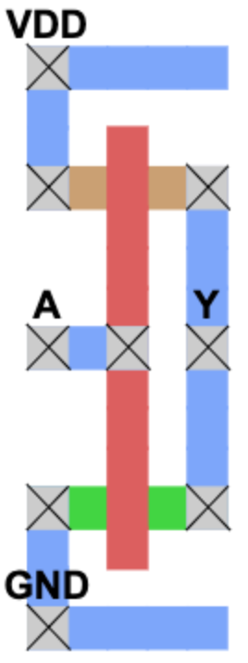
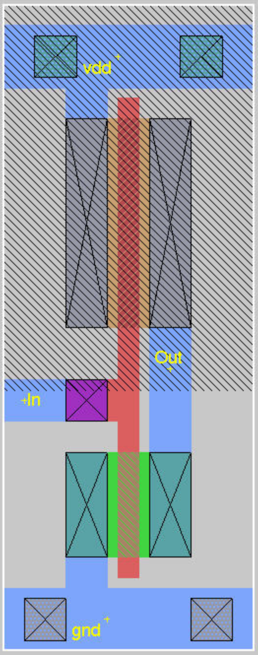
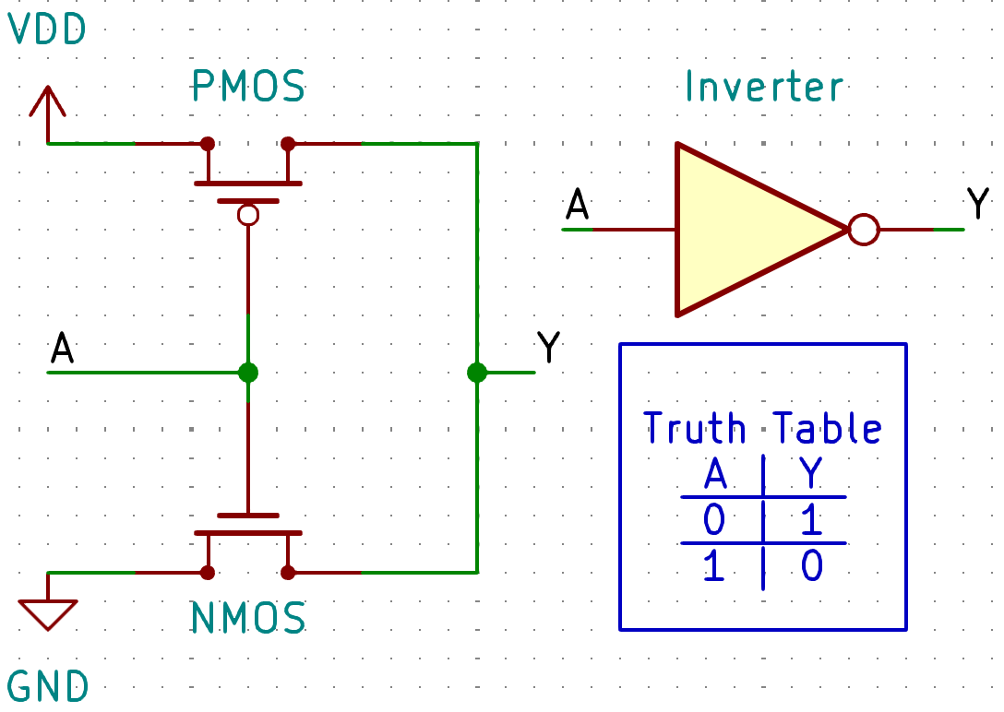
Physical Layout Abstractions
1. Logic diagram
2. CMOS circuit schematic
3. Topological diagram
4. Full Layout
[1] J. D. Williams, “Sticks -- a new approach to lsi design,” Master’s thesis, Massachusetts Institute of Technology, June 1977.

Slide 4
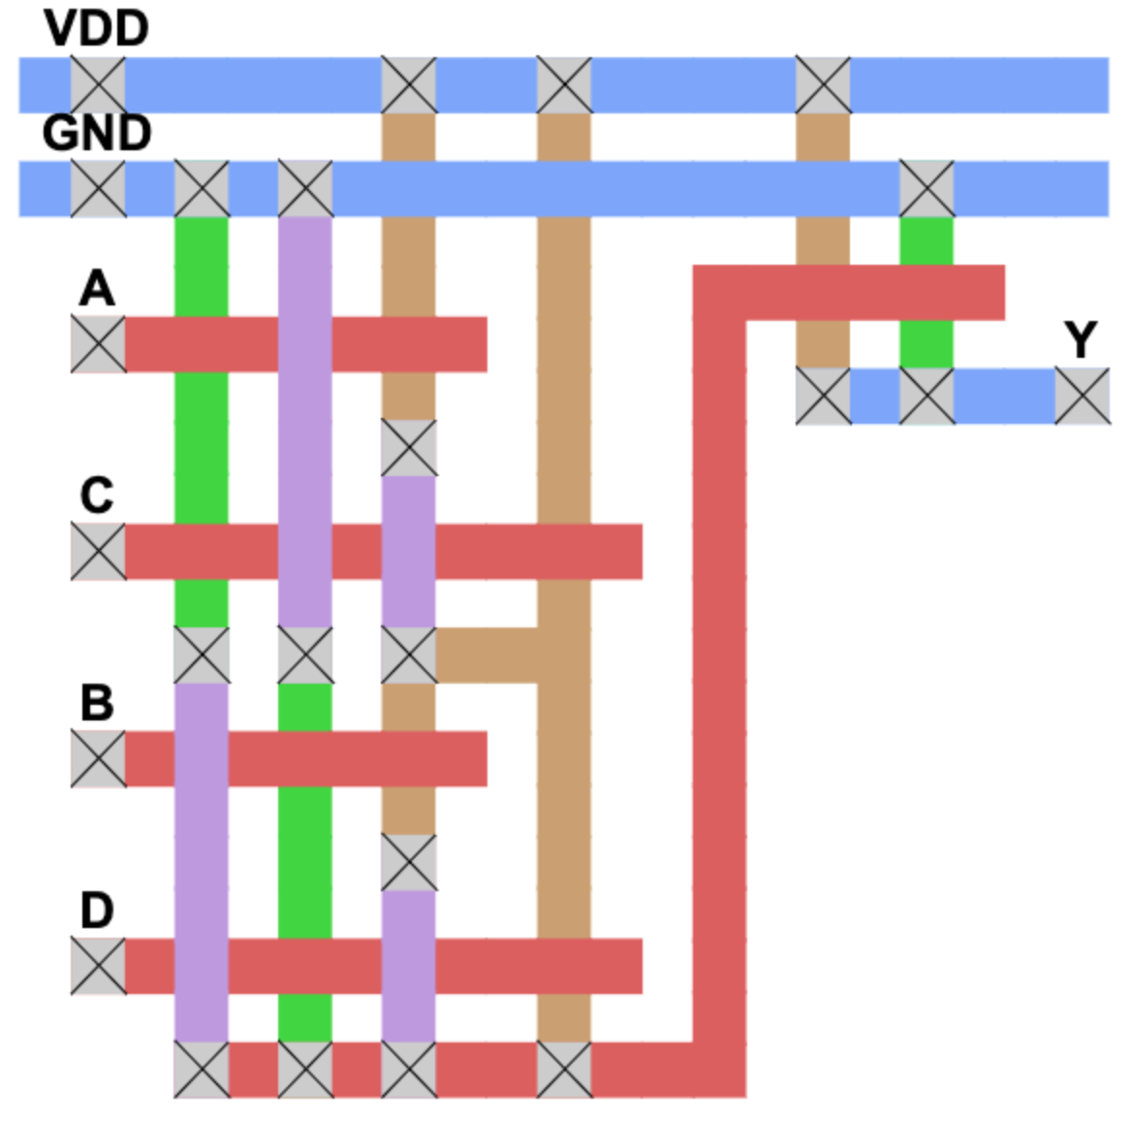
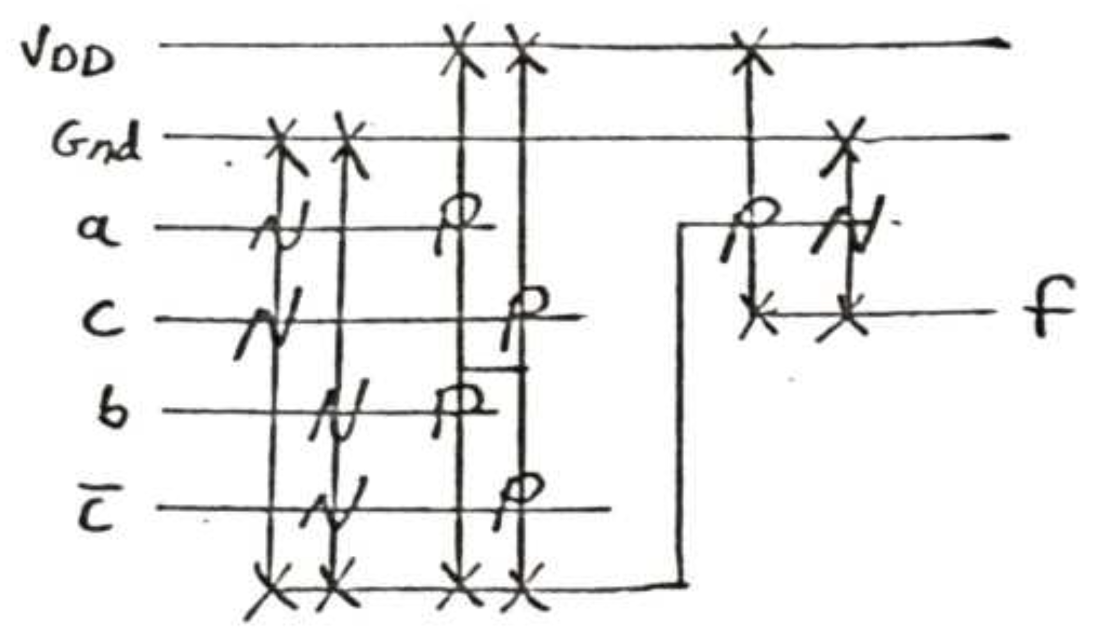
Topological “Stick” Diagrams
A freehand monochrome stick diagram from J.D. Williams’s 1977 thesis^{[1]}.
The same stick diagram redrawn with color-coding.
(¬C and f are relabeled as D and Y, respectively.)

Slide 5
More about Stick Diagrams
Stick diagrams are used to:
Visualize connections within an IC chip
Plan final layout
Estimate required die area
They are typically drawn freehand
Fast and easy
Length and width of lines don’t matter – only the relative positions of intersections!
But how can you validate a hand-drawn stick diagram?

Slide 6
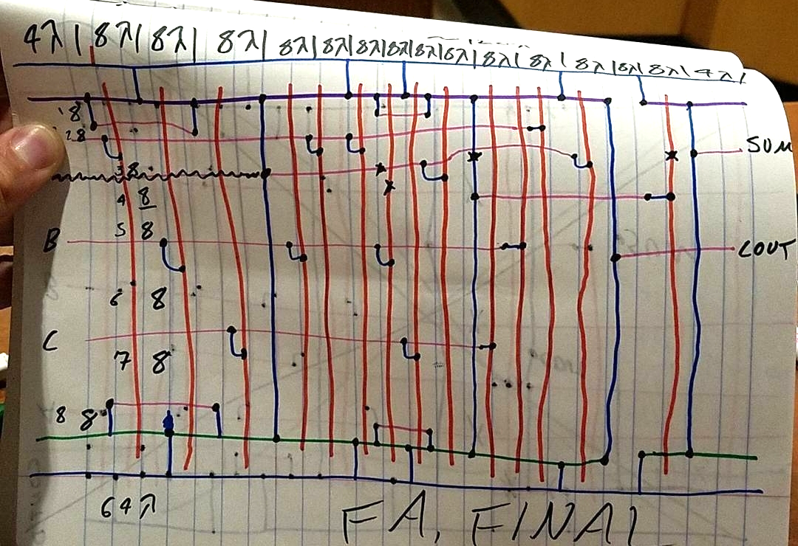
Validating Stick Diagrams
Stick diagrams can be complex
Visual inspection is error-prone
Fixing mistakes during final layout stage is difficult and time-consuming
Stixu is a CAD tool for the VLSI topological abstraction stage
A full adder stick diagram I drew & photographed in 2017.^{[2]}
[2] Ask me about this footnote during Q&A!

Slide 7
Live Demo: https://stixu.io/?demo=1

Slide 8
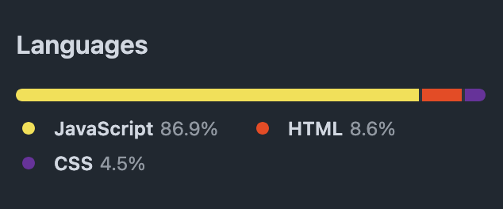
Framework Overview
Static web server
(Optional)
Runs in the web browser
Completely static client-side execution
Can be hosted on a server, but this is not required
Web Browser
HTML
Javascript
CSS

Slide 9
Extending the Code: IRSIM

Slide 10
Basic Approach
Write IRSIM header
For each Stixu transistor…
Create named IRSIM nets for gate, drain, and source
Create an IRSIM transistor connected to those nets
For inputs and outputs…
Create named IRSIM nets
For GND and VDD…
Create named IRSIM nets
Set up as supplies
For all identical Stixu hyperedges (nets)…
Interconnect IRSIM with named aliases

Slide 11
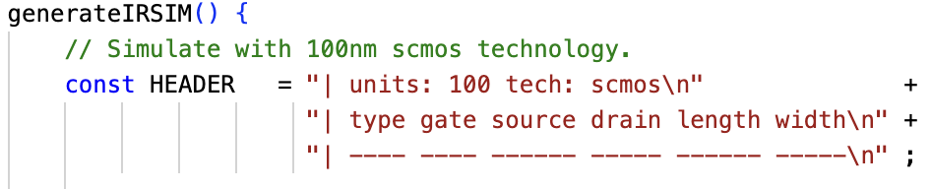
Header Information

Slide 12
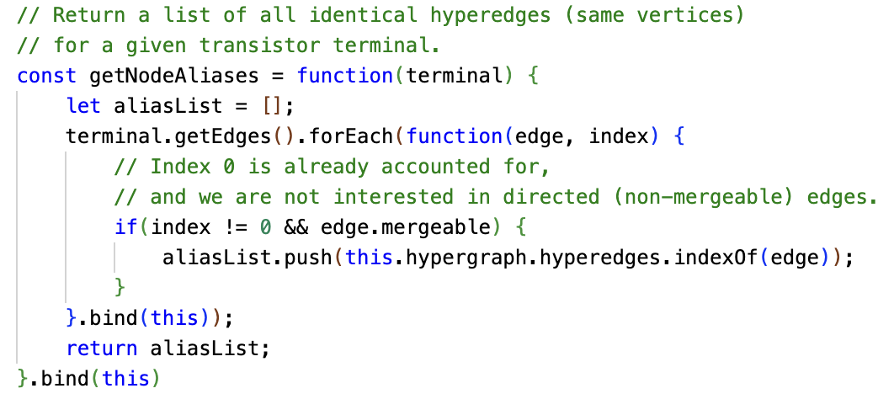

Extract Transistors (1/2)
N1’s drain &
N2’s source are identical nets
T1
T2

Slide 13
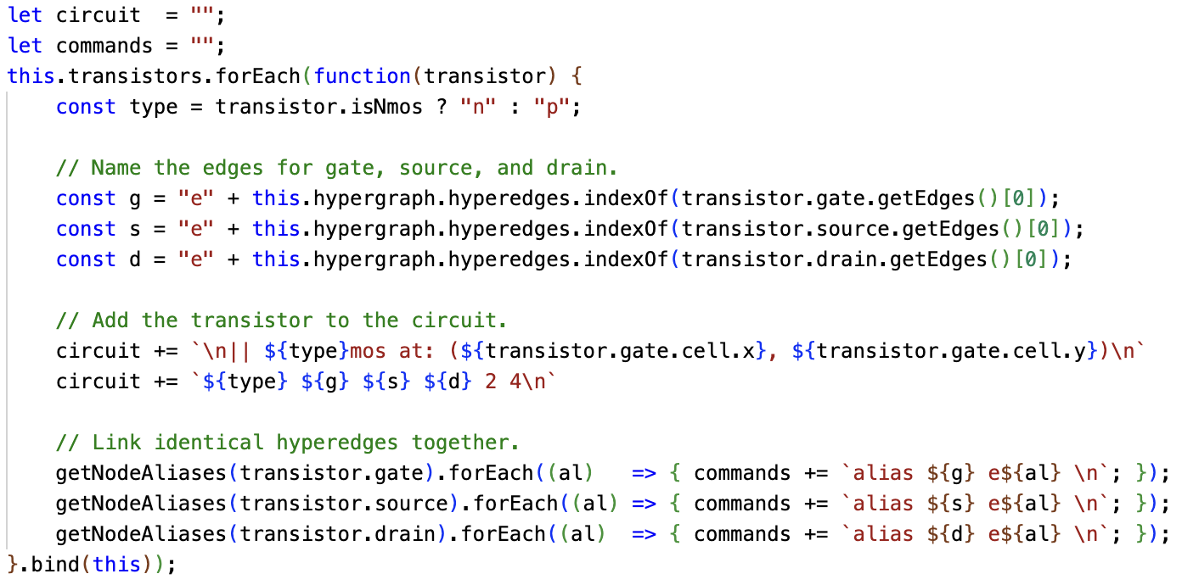
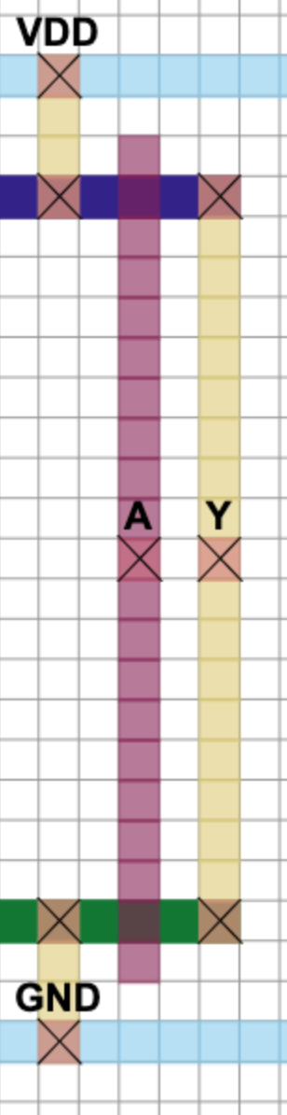
Extract Transistors (2/2)

Slide 14
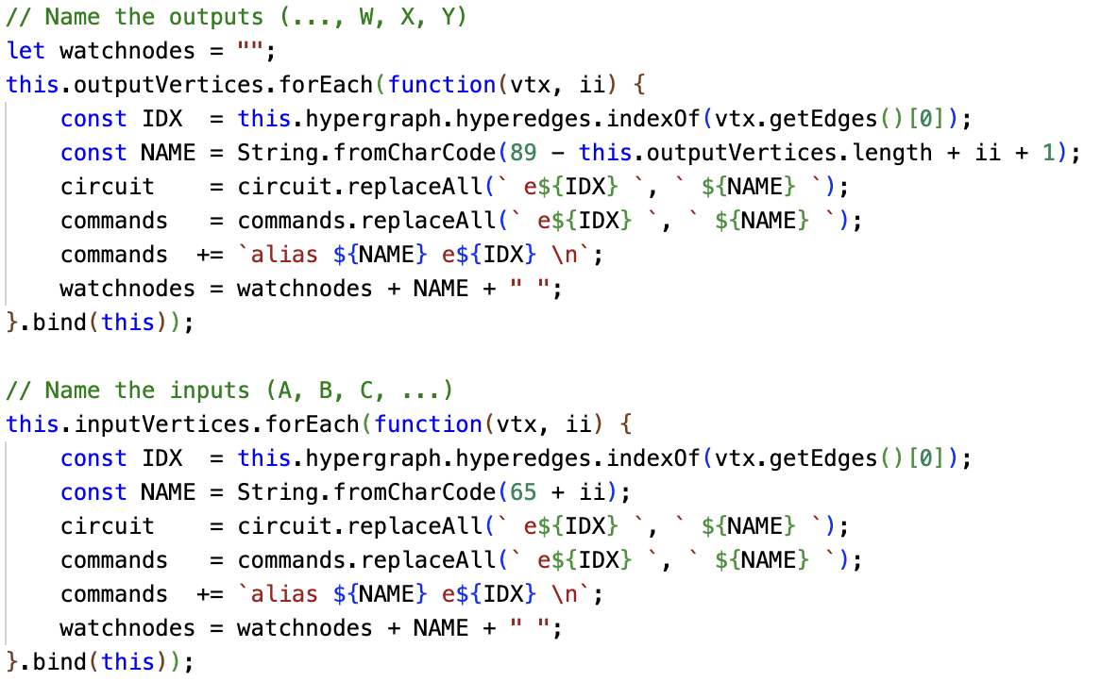
Extract Inputs & Outputs

Slide 15
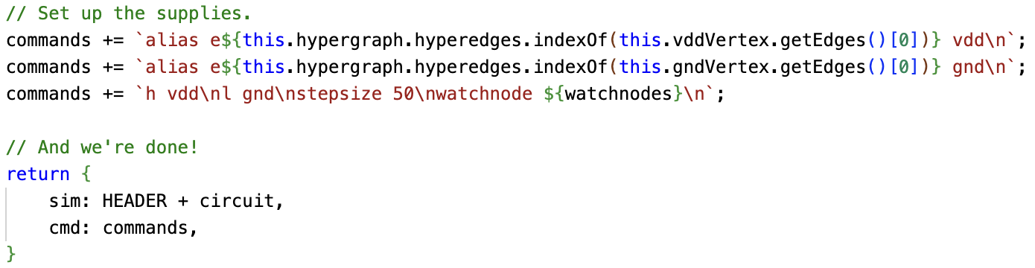
Set Supplies & Return

Slide 16
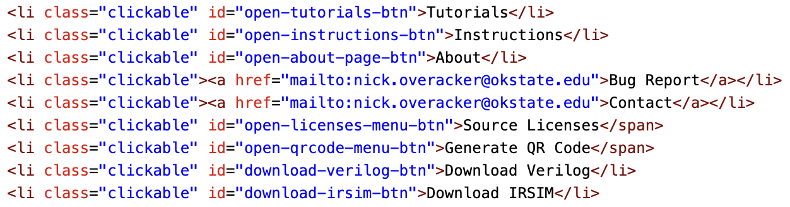

Make it Usable (1/2)
Add a button to the index.html file…
Tol
Sorcery
Themes
Stix

Slide 17
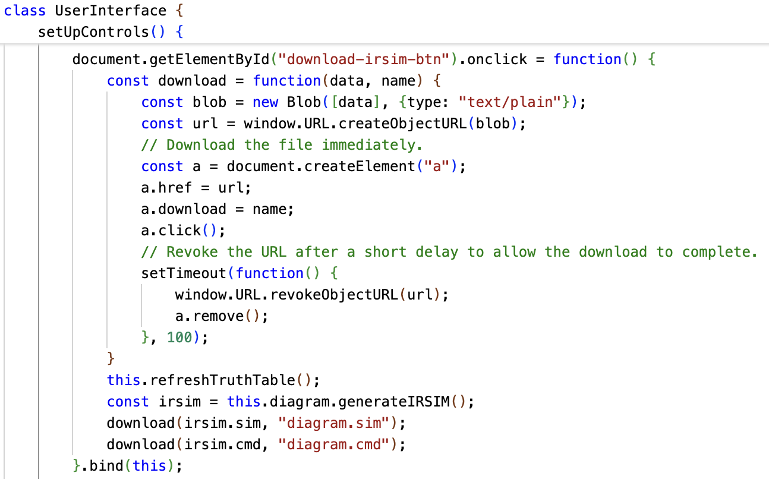
Make it Usable (2/2)
Enable it:
And we’re done!
See code as git diff: link
Tol
Sorcery
Themes
Stix

Slide 18
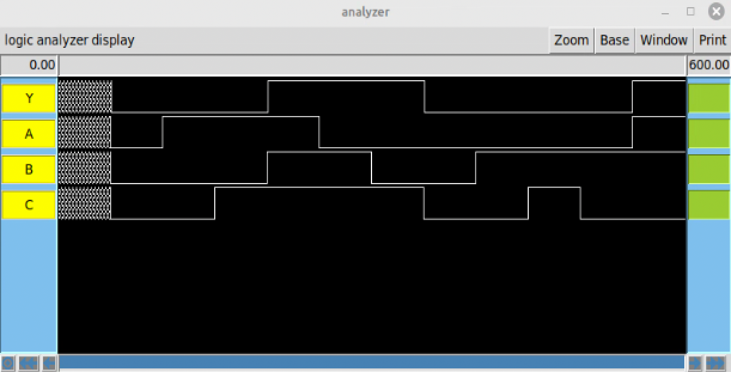
Use it!

Slide 19
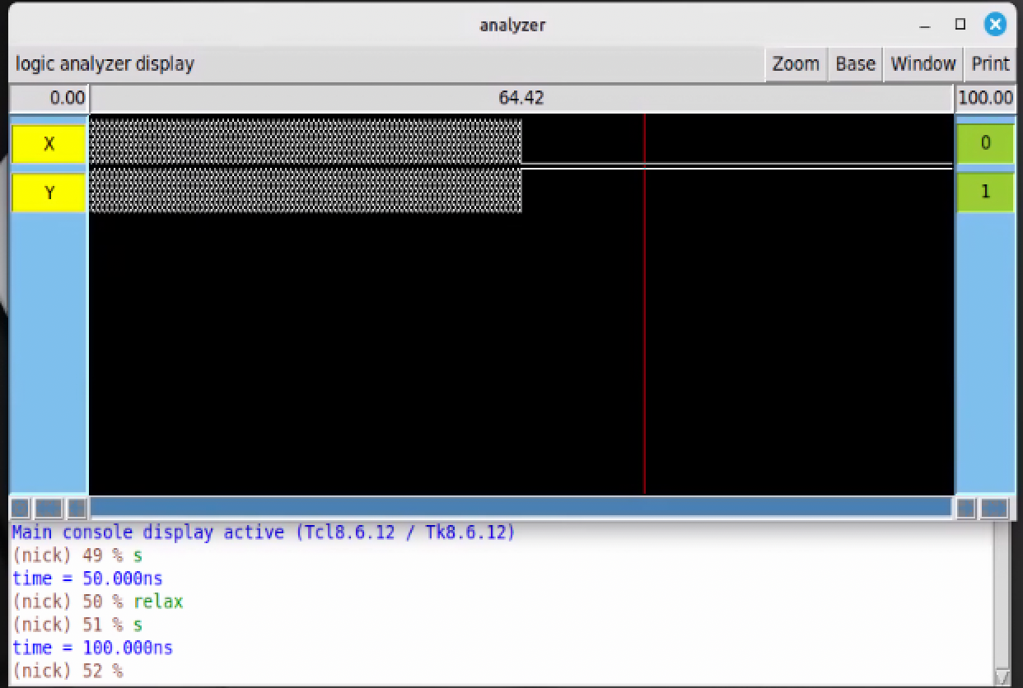
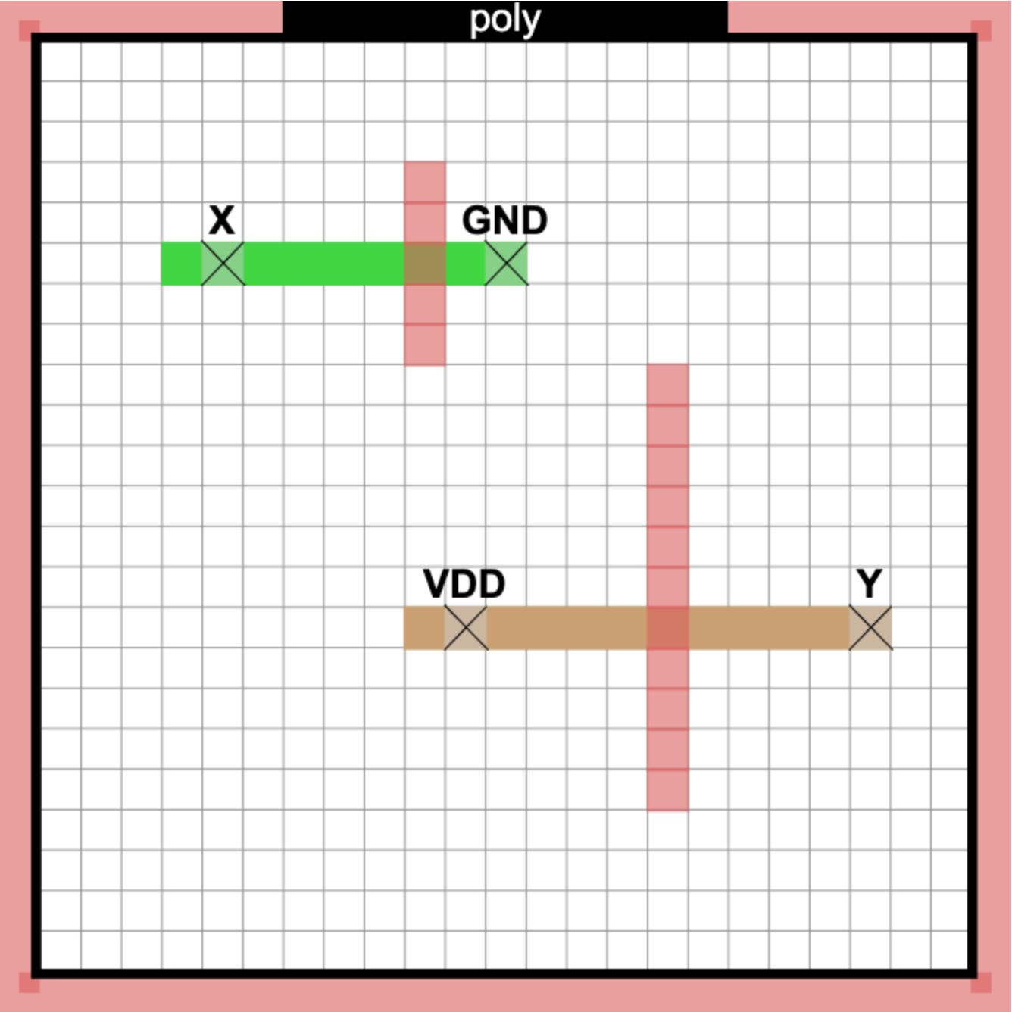
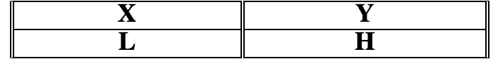
Quick Note: “Settled” Values

Slide 20

Thank you!
Nicholas Overacker
Kitami Institute of Technology (Master’s Year 2)
Oklahoma State University (B.S.)
nick.overacker@okstate.edu
m3235380013@std.kitami-it.ac.jp

Slide 21
References
[1] N. Overacker, J. Stine, M. Ptaszynski, S. Yoshizawa, and M. Kobayashi, “Stixu: An open-source idea for planning integrated circuit layouts efficiently,” in TENCON 2024 - 2024 IEEE Region 10 Conference (TENCON), 2024, pp. 782–785.
[2] J. Sparsø, “Asynchronous circuit design - a tutorial,” 2001. [Online]. Available: https://api.semanticscholar.org/CorpusID:67482001
[3] B. Praggastis, S. Aksoy, D. Arendt, M. Bonicillo, C. Joslyn, E. Purvine, M. Shapiro, and J. Y. Yun, “Hypernetx: A python package for modeling complex network data as hypergraphs,” Journal of Open Source Software, vol. 9, no. 95, p. 6016, 2024. [Online]. Available: https://doi.org/10.21105/joss.06016

Slide 22
:
An Open-Source Idea for Planning Integrated Circuit Layouts Efficiently
IEEE TENCON 2024 (Singapore)
Nicholas Overacker ^{a, b}, Dr. James Stine ª, Dr. Michal Ptaszynski ^{b}, Dr. Shingo Yoshizawa ^{b}, Miho Kobayashi ^{c}
ª Oklahoma State University
^{b} Kitami Institute of Technology
^{c} Independent UI designer

Slide 23
Background & Motivation

Slide 24
Traditional LSI Design Stages^{[1]}
1. Logic diagram
2. CMOS circuit schematic
3. Topological diagram
4. Full Layout
[1] J. D. Williams, “Sticks -- a new approach to lsi design,” Master’s thesis, Massachusetts Institute of Technology, June 1977.

Slide 25
Topological “Stick” Diagrams
A freehand monochrome stick diagram from J.D. Williams’s 1977 thesis^{[1]}.
The same stick diagram redrawn with color-coding.
(¬C and f are relabeled as D and Y, respectively.)

Slide 26
More about Stick Diagrams
Stick diagrams are used to:
Visualize connections within an IC chip
Plan final layout
Estimate required die area
They are typically drawn freehand
Fast and easy
Length and width of lines don’t matter – only the relative positions of intersections!
But how can you validate a hand-drawn stick diagram?

Slide 27
Validating Stick Diagrams
Stick diagrams can be complex
Visual inspection is error-prone
Fixing mistakes during final layout stage is difficult and time-consuming
Stixu is a CAD tool for the VLSI topological abstraction stage
A full adder stick diagram I drew & photographed in 2017.^{[2]}
[2] Ask me about this footnote during Q&A!

Slide 28
Stixu Stick Diagrammer

Slide 29
What is Stixu?
A browser-based tool for drawing and validating CMOS stick diagrams
For students, teachers, and researchers
Shows the whole output path of a circuit for any input
Source-available and free for non-commercial use
https://github.com/NickOveracker/StickDiagrammer/
There is not yet a safe and stable release that is suitable for business use
Try it on your phone: https://stixu.io/

Slide 30



Themes
Stixu has 3 palettes for layer colors
Tol is the default
Colorblind-friendly
Sorcery is the Magic VLSI palette
Stix is the original Stixu palette
Layers
pdiff ndiff poly metal1 metal2 contact
Tol
Sorcery
Themes
Stix

Slide 31
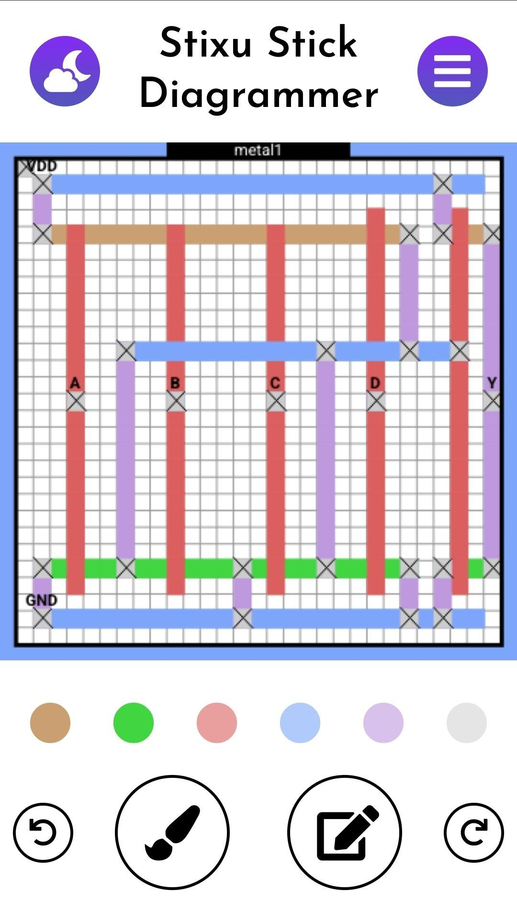
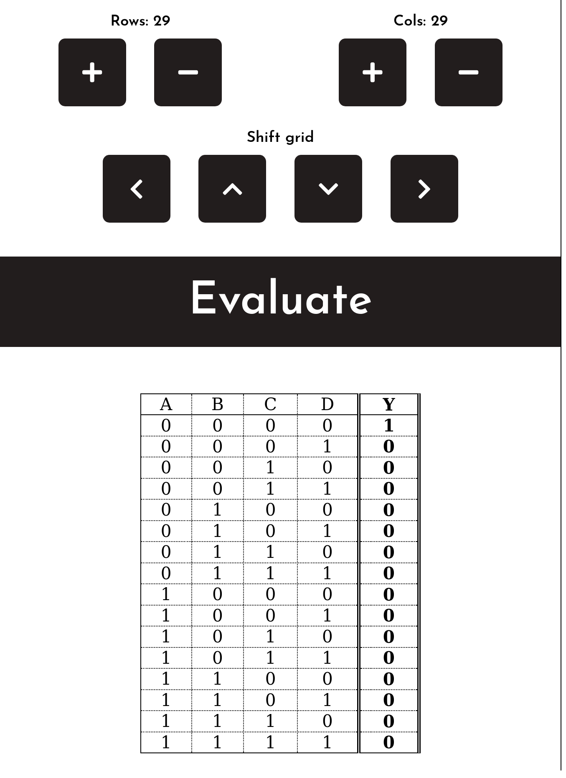
Getting Started
Dark mode
toggle
Options and information
Add/Remove Rows
Add/Remove Columns
Active layer
indicator
Shift entire grid
The best way to start is with the mobile interface
Simple and minimal UI
… yet still full-featured!
Mobile-first design
The faster and more flexible PC UI is easy to learn after mastering the mobile interface.
Canvas
Generate & View Truth Table
Layer selector
Paint/Erase
toggle
I/O contact menu
Undo
Redo

Slide 32
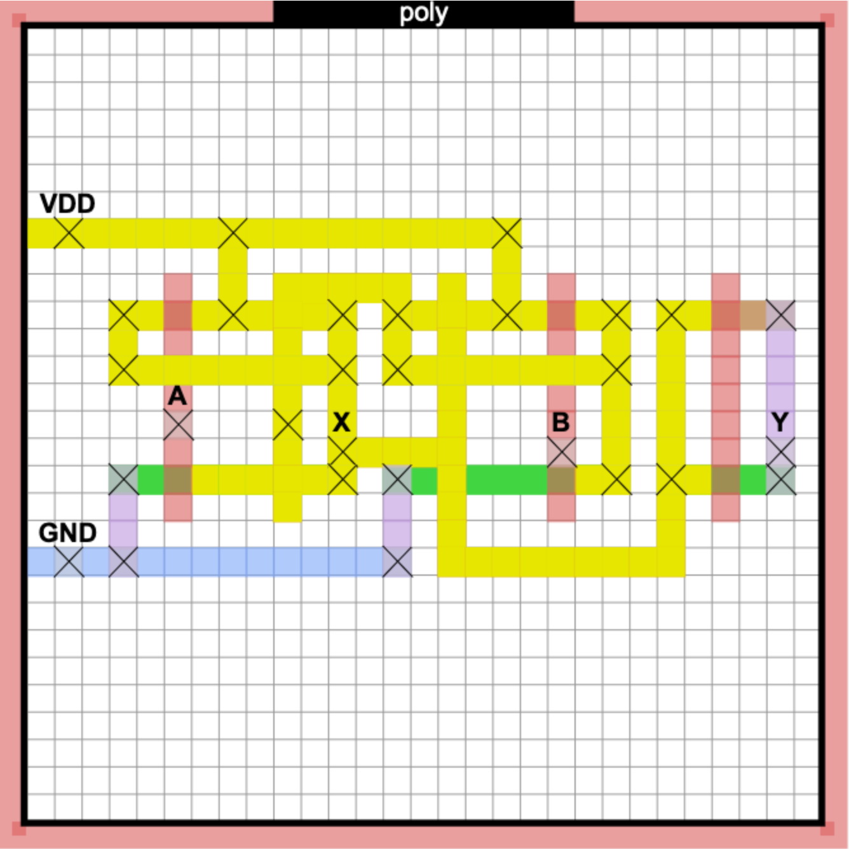
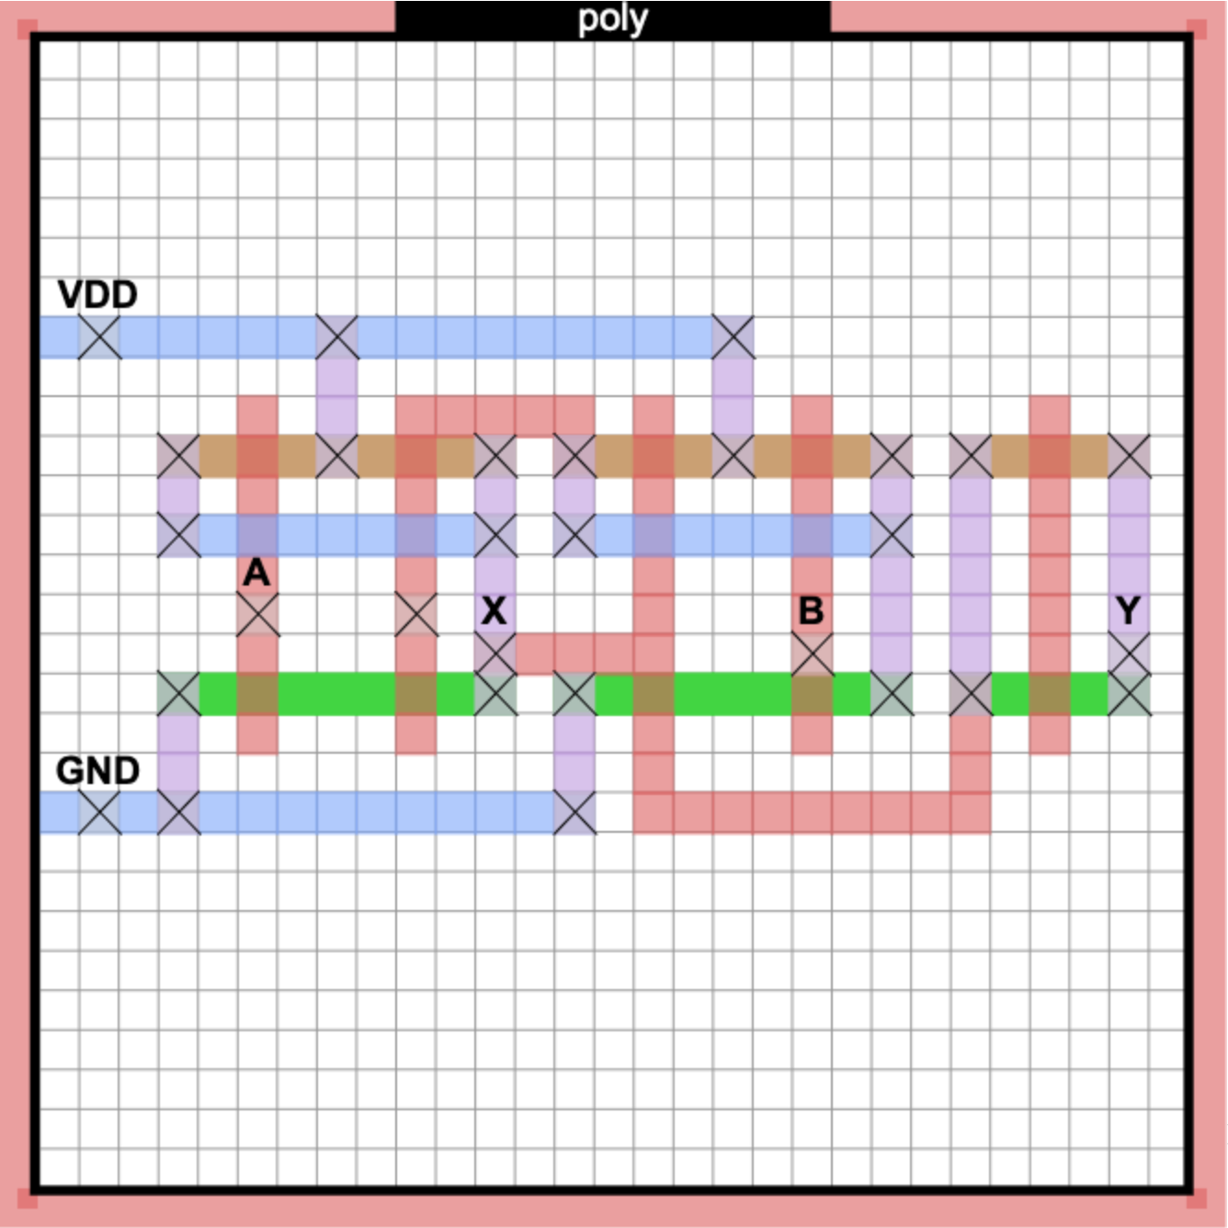
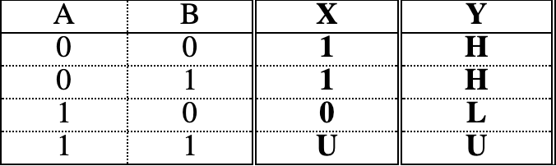
Output Analysis
Stixu produces 1 of 7 possible outputs for each input vector:
0 – Logical low (V_{SS} / GND)
1 – Logical high (V_{DD} )
Z – Floating (high impedance)
X – Indeterminate (short-circuit)
L – Unstable logic low (floating)
H – Unstable logic high (floating)
U – Unknown (no short-circuit)
Tap an output value to see the signal path!

Slide 33
The Hypergraph Model
Stixu models stick diagrams as hypergraphs
A generalization of traditional graphs
Hyperedges can be connected to multiple vertices (i.e., nodes)
Vertices are individual primitive elements
VDD, GND, inputs, outputs, transistor gate/source/node terminals, LO, and HI
Hyperedges are nets of primitive elements
Output values are found by testing paths from LO/HI to output vertices
LO and HI are distinct from GND and VDD
Not visible on the stick diagram

Slide 34
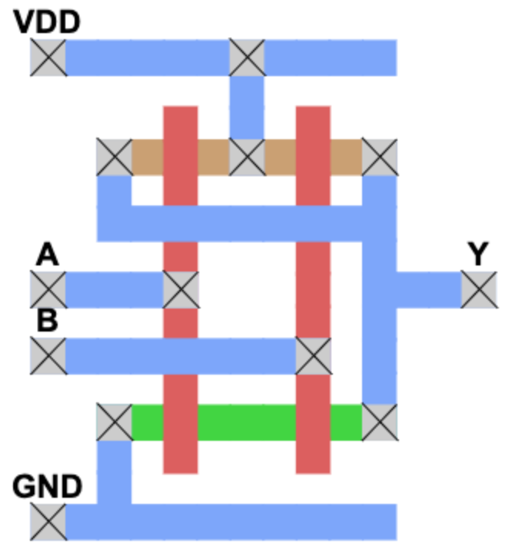
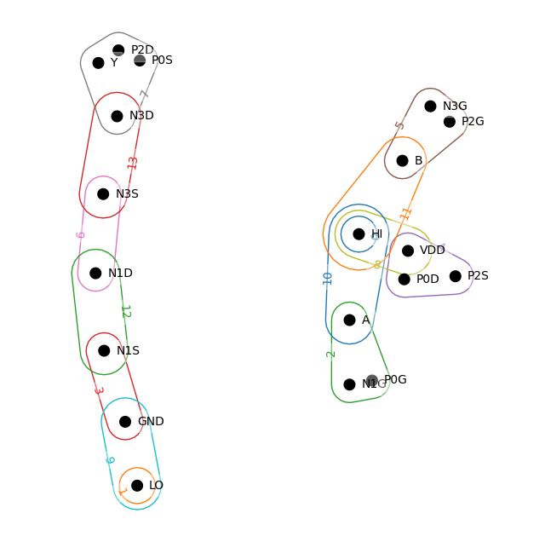
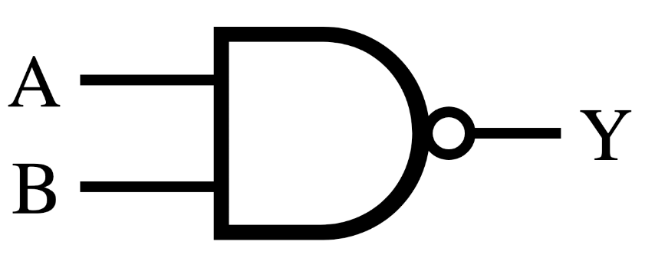
Hypergraph Model Visualized
(A = 1, B = 1)
Notes:
SYNCHRONIZE TIMING

Slide 35
What does this contribute?

Slide 36
What’s the Point?
Possibly the only free and publicly available stick diagramming tool
Prior stick diagramming tools in the literature are ~40 years old and not publicly available
A free and public tool contributes to the growing “open source silicon” movement
Useful in the classroom
Students can easily experiment and gain intuition for stick diagrams
Instructors can quickly validate diagram correctness
Useful for publications
Authors can quickly illustrate, validate, and share circuit topologies
Easier than using general drawing software such as MS Paint

Slide 37
Tests and Limitations

Slide 38
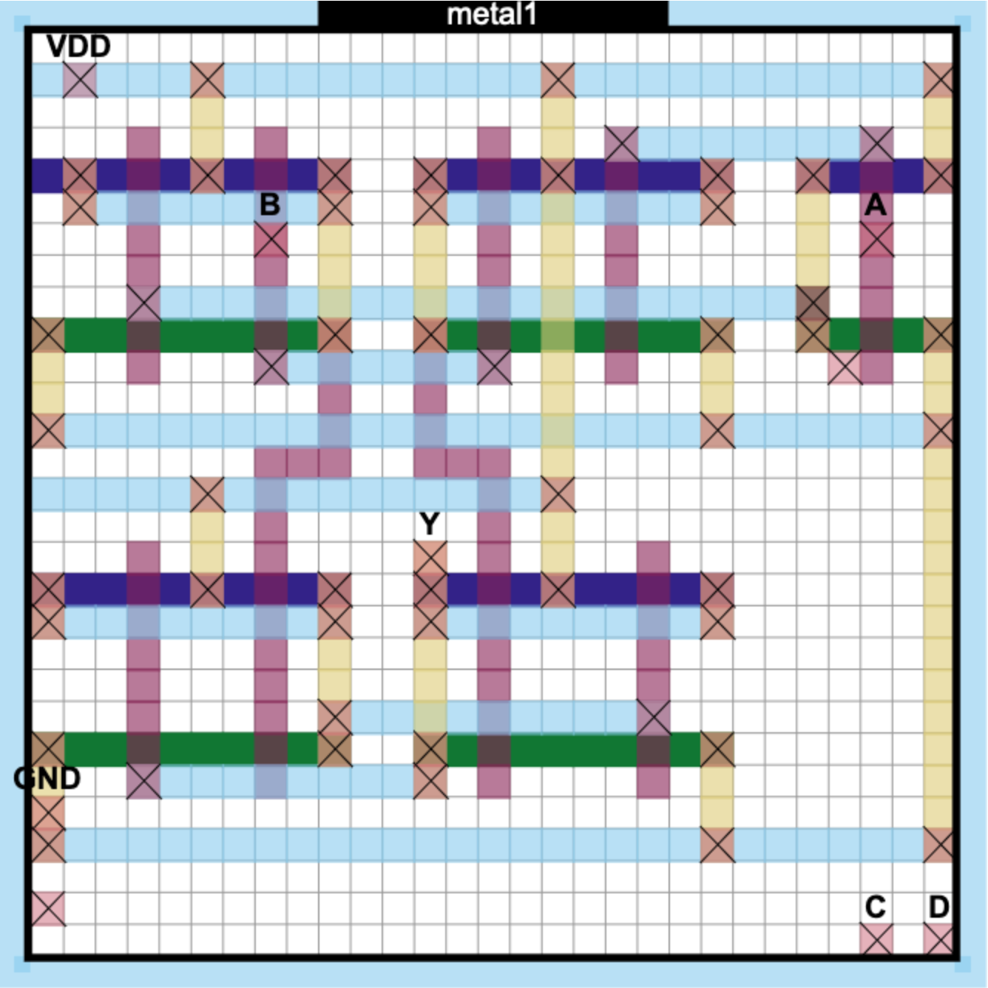
Testbench
All testbench cases can be seen at https://stixu.io/test
51 different circuit topology test cases
4 rotations * 2 reflections = 8 tests per topology
8 UI interaction tests
Dark mode toggle, add/remove terminals, etc
1 “always fail” test
Validates the testbench itself
Tested topologies range from a 5-stage inverter to a D flip-flop
Test 25: D latch

Slide 39
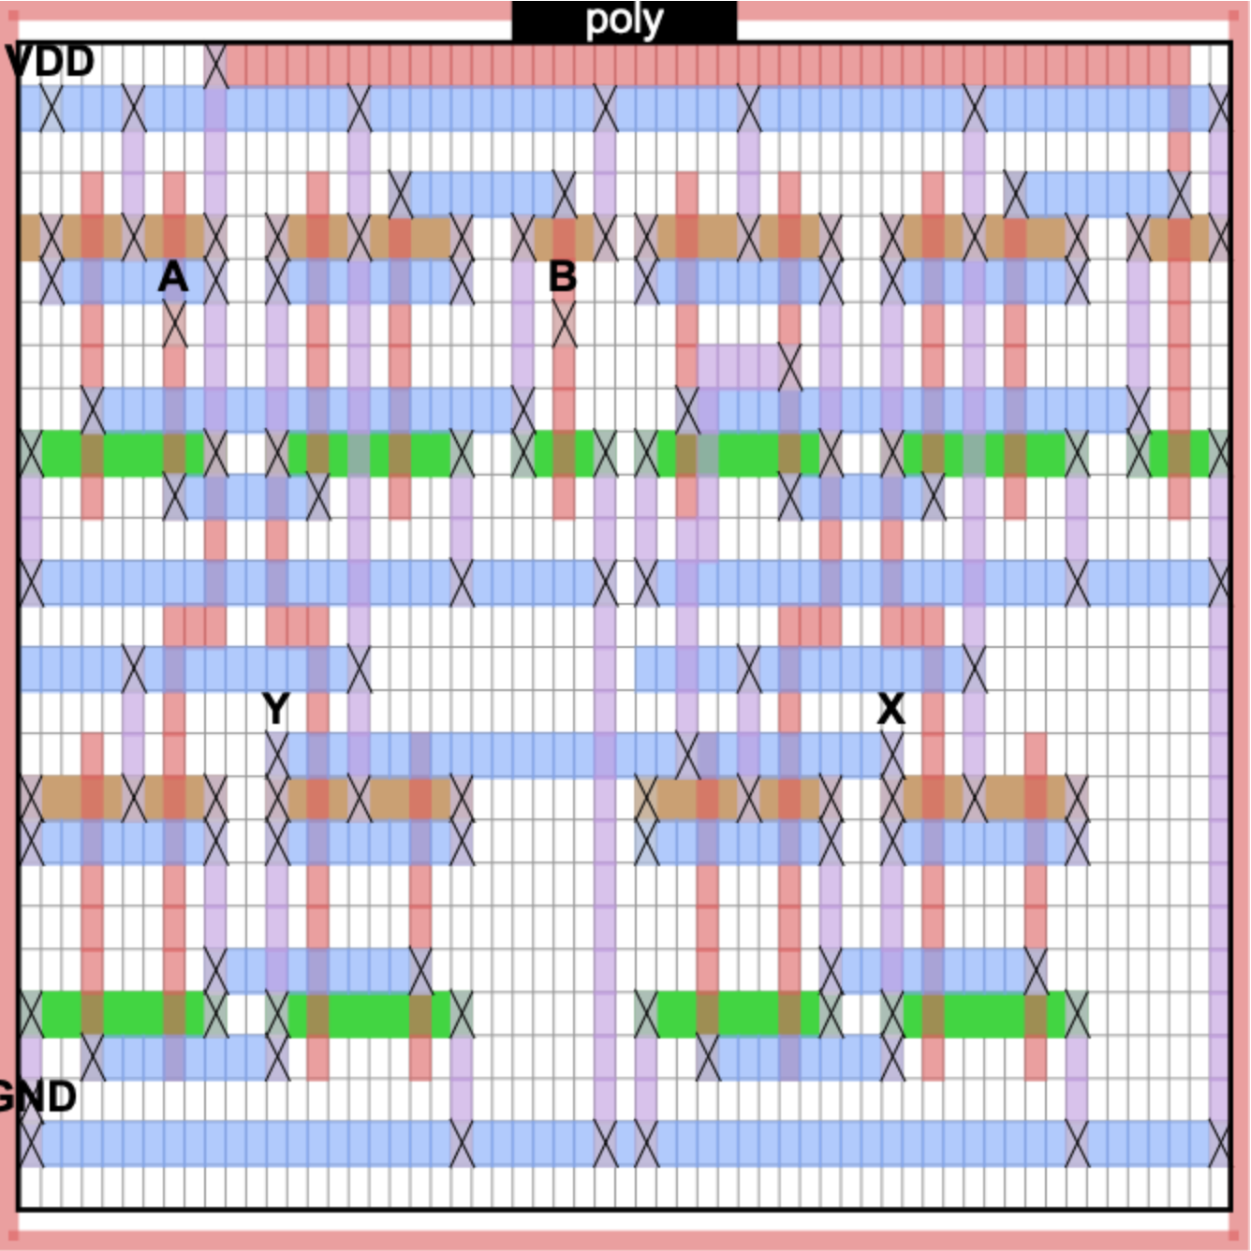
Limitations
Floating gate analysis has O(2^{N}) time complexity
Scales with the number of floating gates (N)
The problem reduces to the NP-Complete “BSAT” problem
This is intrinsic to the task
Perhaps heuristic approaches can be applied in constrained cases
Only static analysis
Purely digital – no consideration of analog effects
Difficult to rigorously validate the algorithm
Currently only empirically validated
Rigorous examination may be the topic of a future paper
Complex topologies with several floating gates take a significant amount of time to analyze. (Test 54, ~2s runtime)

Slide 40
Next Steps

Slide 41
Future Development Goals
Classroom integration features
Homework assignment, submission, grading, etc.
Improved diagram saving/sharing/loading
Currently only implemented by encoding circuit as a QR code
Modular design
Use pre-made diagrams as black box modules for more complex, large-scale designs
Interoperability
HDL generation, Magic layout generation
Area estimation, logical/electrical effort computation, and more!

Slide 42
Thank you!
Nicholas Overacker
Kitami Institute of Technology (Master’s Year 2)
Oklahoma State University (B.S.)
nick.overacker@okstate.edu
m3235380013@std.kitami-it.ac.jp

Slide 43
References
1] J. D. Williams, “Sticks–a new approach to lsi design,” Master’s thesis, Massachusetts Institute of Technology, June 1977.
[2] H. Watanabe, IC Layout Generation and Compaction Using Mathematical Optimization. PhD thesis, University of Rochester, 1984.
[3] J. D. Williams, “Sticks - a graphical compiler for high level lsl design,” in Managing Requirements Knowledge, International Workshop on, (Los Alamitos, CA, USA), p. 289, IEEE Computer Society, jun 1978.
[4] S. Trimberger, “The proposed sticks standard,” Tech. Rep. Technical Report 3880, California Institute of Technology, October 1980.
[5] N. Weste and D. Harris, CMOS VLSI Design: A Circuits and Systems Perspective. USA: Addison-Wesley Publishing Company, 4th ed., 2010.
[6] M. Terai, Y. Ajioka, T. Noda, M. Ozaki, T. Umeki, and K. Sato, “Symbolic layout system: Application results and functional improvements,” IEEE Transactions on Computer-Aided Design of Integrated Circuits and Systems, vol. 6, no. 3, pp. 346–354, 1987.
[7] R.-D. Fiebrich, Y.-Z. Liao, G. M. Koppelman, and E. N. Adams, “Psi: A symbolic layout system,” IBM J. Res. Dev., vol. 28, pp. 572–580, 1984.
[8] P. Tol, “Colour schemes.” Available at https://personal.sron.nl/∼pault/data/colourschemes.pdf, 2021. Accessed: 2024/5/23.
[9] N. Overacker and M. Kobayashi, “Stickdiagrammer.” Available at https://github.com/NickOveracker/StickDiagrammer. Accessed: 2024/5/25.
[10] N. Overacker and M. Kobayashi, “Stixu testbench.” Available at https://stixu.io/test/. Accessed: 2024/5/25.
[11] M. Venn and U. Shaked, “Tiny tapeout.” Available at https://tinytapeout.com/. Accessed: 2024/5/24.
[12] U. Shaked, “Siliwiz.” Available at https://app.siliwiz.com. Accessed: 2024/5/24.
[13] “Vital sine.” Available at https://www.youtube.com/@VitalSine. Accessed: 2024/5/24.

